Slide 1

Stona Yoga
Battle of the Neighborhoods in Seattle, WA

Slide 2
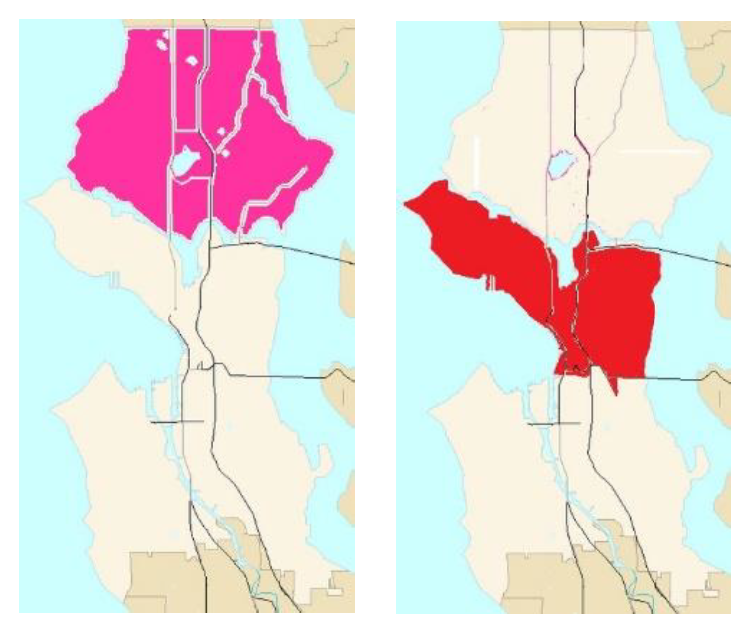
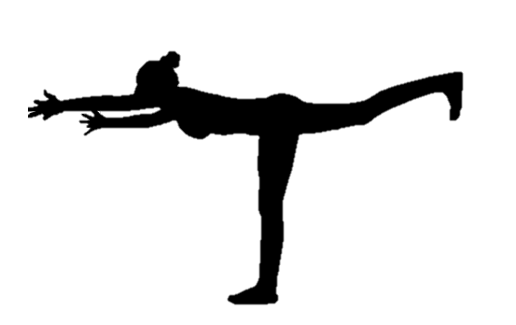
Problem statement
Mary Jane want to find out if it is feasible to open a Stona Yoga Studio in in the northern and central neighborhoods of Seattle, WA.
If feasible, which neighborhood is the best?

Slide 3

Stona Yoga Studio
What is a STONA YOGA STUDIO?
A Stona Yoga studio is similar to a regular yoga studio with the difference being that before class in a Stona Yoga studio, the teacher and students smoke and share a joint.
What are the benefits of combining cannabis with yoga?
increased lung capacity
regulation and prevention of diabetes
helps with weight loss
relieves depression and
aids in inflammatory conditions
increased mind-body-breath connection

Slide 4
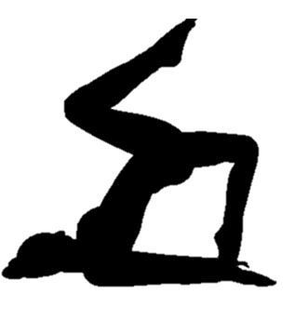
Data Sources
A list of neighborhoods in north and central Seattle is available on the internet at:
https://en.wikipedia.org/wiki/List_of_neighborhoods_in_Seattle
The Python library Geopy was used to get coordinates for the neighborhoods.
“Geopy makes it easy for Python developers to locate the coordinates of addresses, cities, countries, and landmarks across the globe using third-party geocoders and other data sources.”
Foursquare was used to get location data for analysis.
Foursquare is an “independent location data platform for understanding how people move through the real world”

Slide 5
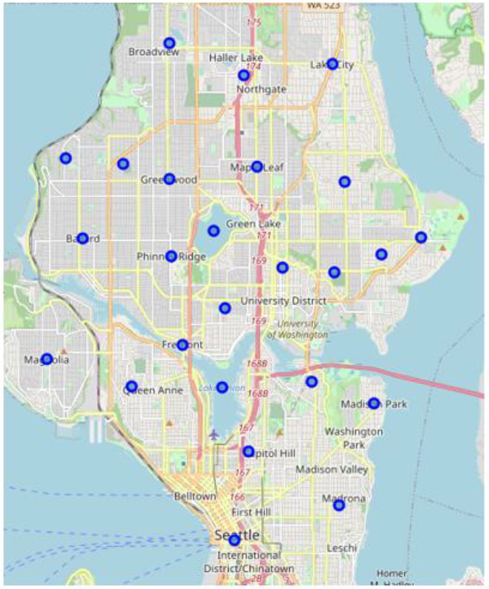
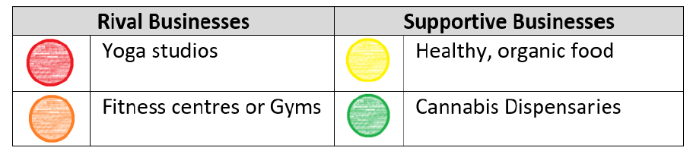

Neighborhood clusters
The neighborhoods in north and central Seattle were divided into 25 clusters to gather location data for.
These clusters were analysed to get location data on primary and secondary rival and supportive businesses:

Slide 6
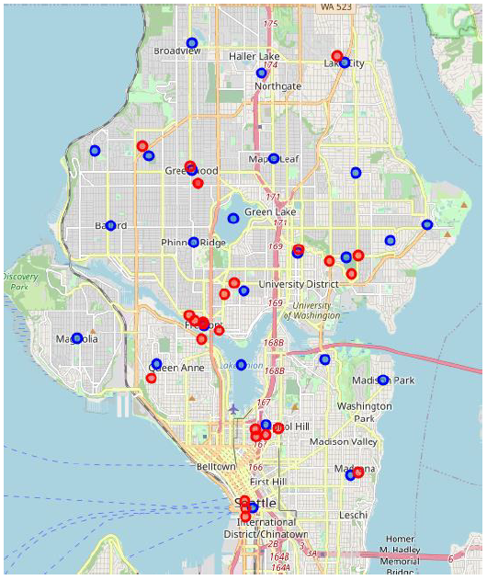
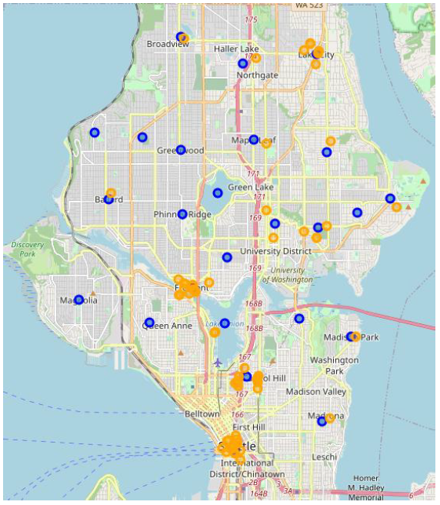

Rival businesses
These are businesses that are in direct or indirect competition with Mary Jane’s Stona Yoga studio.

Slide 7
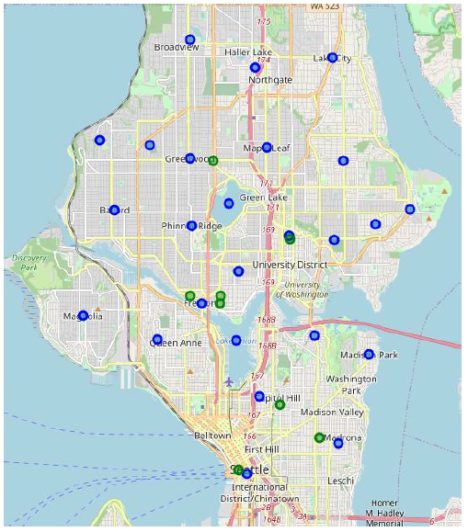
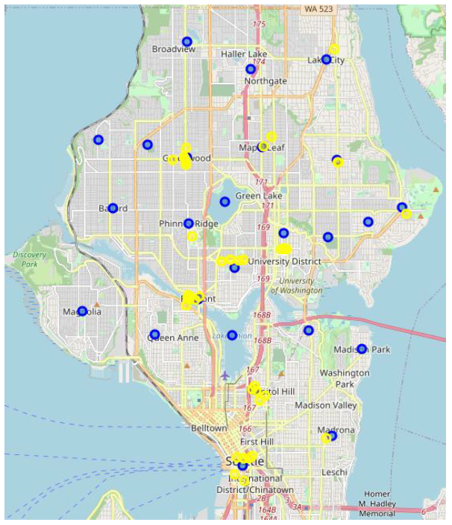
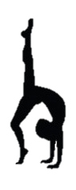
Supporting businesses
These are businesses that a likely to attract people with similar interests to the area

Slide 8
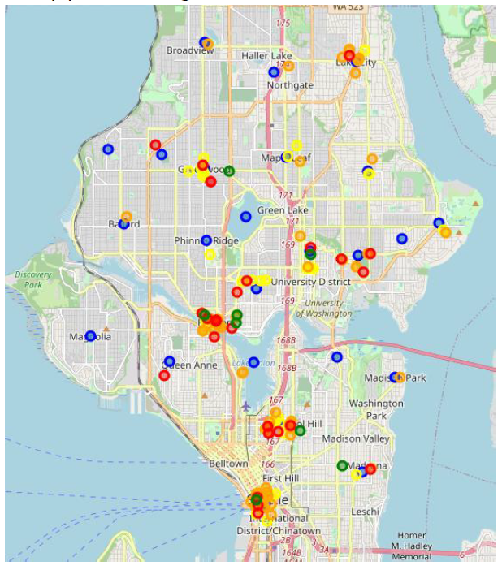
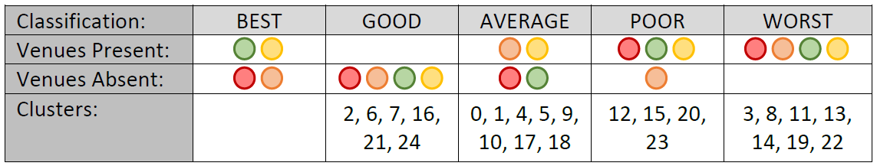
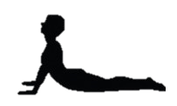
Seattle Location data
Results of location data were categorised into:
No optimal neighborhoods for Mary Jane’s studio.
‘Good’ and ‘Average’ Neighborhoods for consideration exist.

Slide 9
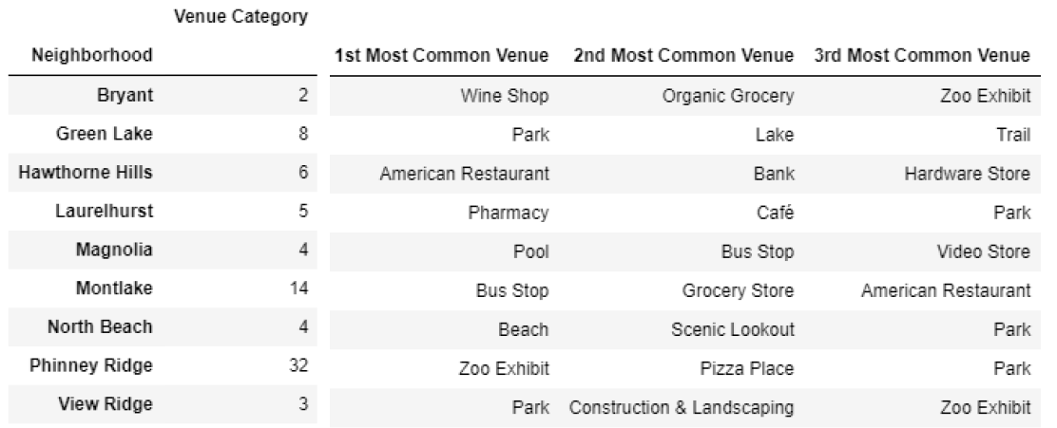

Good neighborhoods
Further analysed to determine types of venues in the areas:

Slide 10

conclusion
No optimal locations exist.
Some good locations for consideration are:
Phinney Ridge
Montlake
Mary Jane can further investigate ‘Good’ and ‘Average’ neighborhoods to determine:
Rental venue availability
Neighborhood population

